Slide 1
Patient Database Management Using Blockchain

Slide 2
Abstract
The Blockchain-Based Patient Data Management System, developed with HTML, CSS, and PHP for frontend and backend operations, leverages Ganache and Truffle for blockchain integration. This innovative system aims to address critical vulnerabilities in traditional medical record-keeping methods, enhancing security and efficiency in processing medical bills and insurance claims. The system facilitates seamless interaction among the Hospital Department, Medical Department, and Insurance Company while ensuring the integrity and confidentiality of patient data. Through the utilization of blockchain technology, patient records and financial information are securely stored on a tamper-resistant ledger, mitigating the risks of data manipulation and unauthorized access.

Slide 3
Introduction
In today's digital age, the management of patient records and healthcare data has become increasingly crucial for ensuring efficient and secure healthcare services. Traditional systems for managing patient databases often face challenges related to data security, privacy, and interoperability. In response to these challenges, innovative technologies such as blockchain are being explored as potential solutions to revolutionize the healthcare industry.
Blockchain: A decentralized, distributed ledger technology that records transactions across multiple nodes in a secure and transparent manner. Each transaction is cryptographically linked to the previous one, forming a chain of blocks

Slide 4
Smart Contracts: Self-executing contracts with predefined rules and conditions encoded on the blockchain. Smart contracts automate and enforce the terms of agreements, eliminating the need for intermediaries.
Decentralization: The distribution of control and authority across multiple nodes or participants in a network. Decentralization enhances security, resilience, and transparency by removing single points of failure.
Patient Database Management: The process of collecting, storing, and managing patient-related information, including medical records, treatment history, and billing data.

Slide 5
Interoperability: The ability of different healthcare systems and applications to exchange and interpret data seamlessly. Interoperability is essential for ensuring the continuity of care and improving healthcare delivery.
ABI (Application Binary Interface): ABI is a standard interface for interaction between smart contracts and other parts of the system. It defines how functions are called and data is transferred in and out of the contract.
Contract Address: A contract address is a unique identifier assigned to each deployed smart contract on the blockchain. It is used to interact with the contract and execute its functions.

Slide 6
Existing System / Literature Survey
Electronic Health Records (EHR) Systems:
EHR systems have become prevalent in healthcare institutions worldwide, digitizing patient health information for easy access and management.
Advantages: EHR systems streamline workflow, improve data accuracy, and facilitate communication among healthcare providers.
Limitations: Despite their advantages, EHR systems face challenges such as data security vulnerabilities, interoperability issues, and user interface complexities.

Slide 7
Health Information Exchange (HIE) Networks:
HIE networks enable the exchange of patient health information between different healthcare entities, allowing for seamless data sharing.
Advantages: HIE networks enhance care coordination, reduce redundancy in tests and procedures, and improve patient outcomes through timely access to medical records.
Limitations: Challenges with data standardization, consent management, and governance hinder the effectiveness of HIE networks. Privacy concerns also arise due to the sharing of sensitive patient information across multiple organizations.

Slide 8
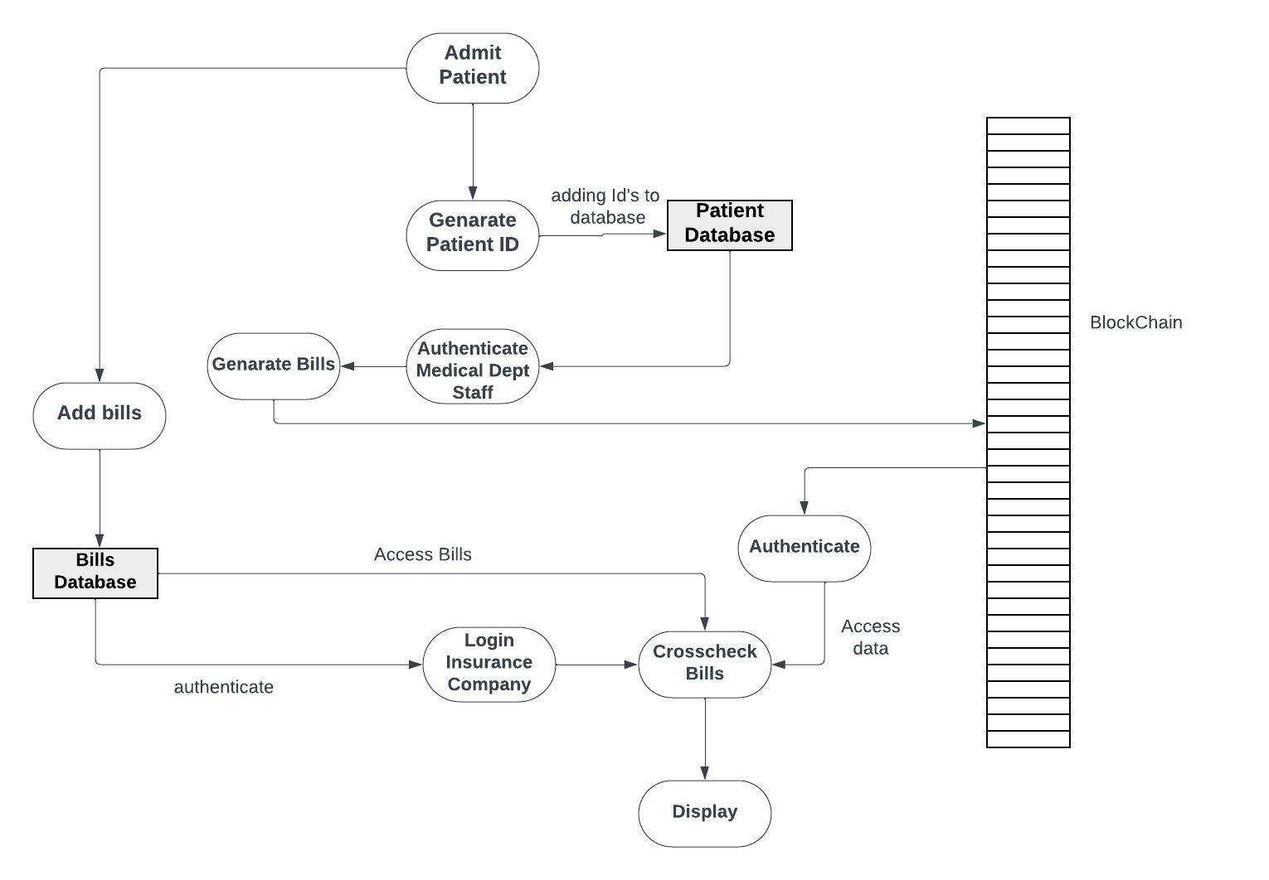
Proposed System

Slide 9
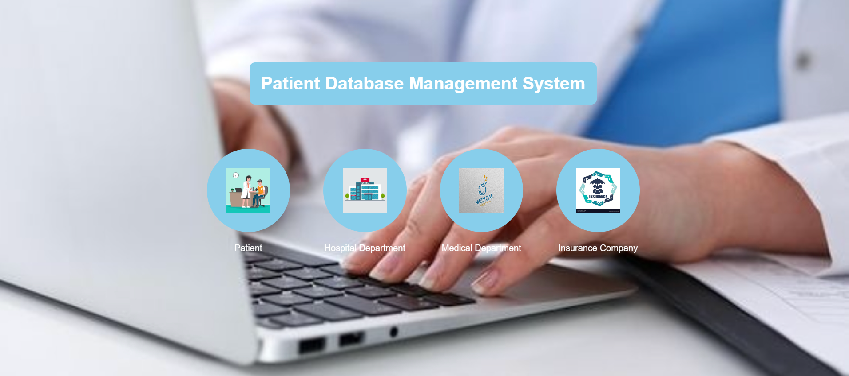
Result /Performance Evaluation

Slide 10
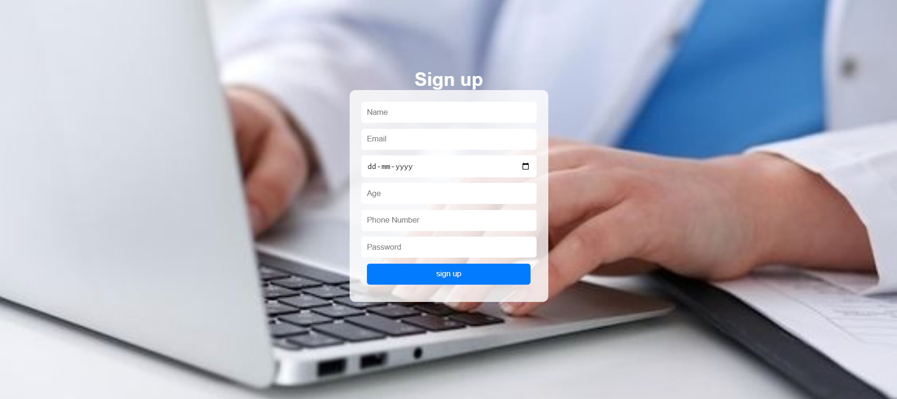
Registration page:

Slide 11
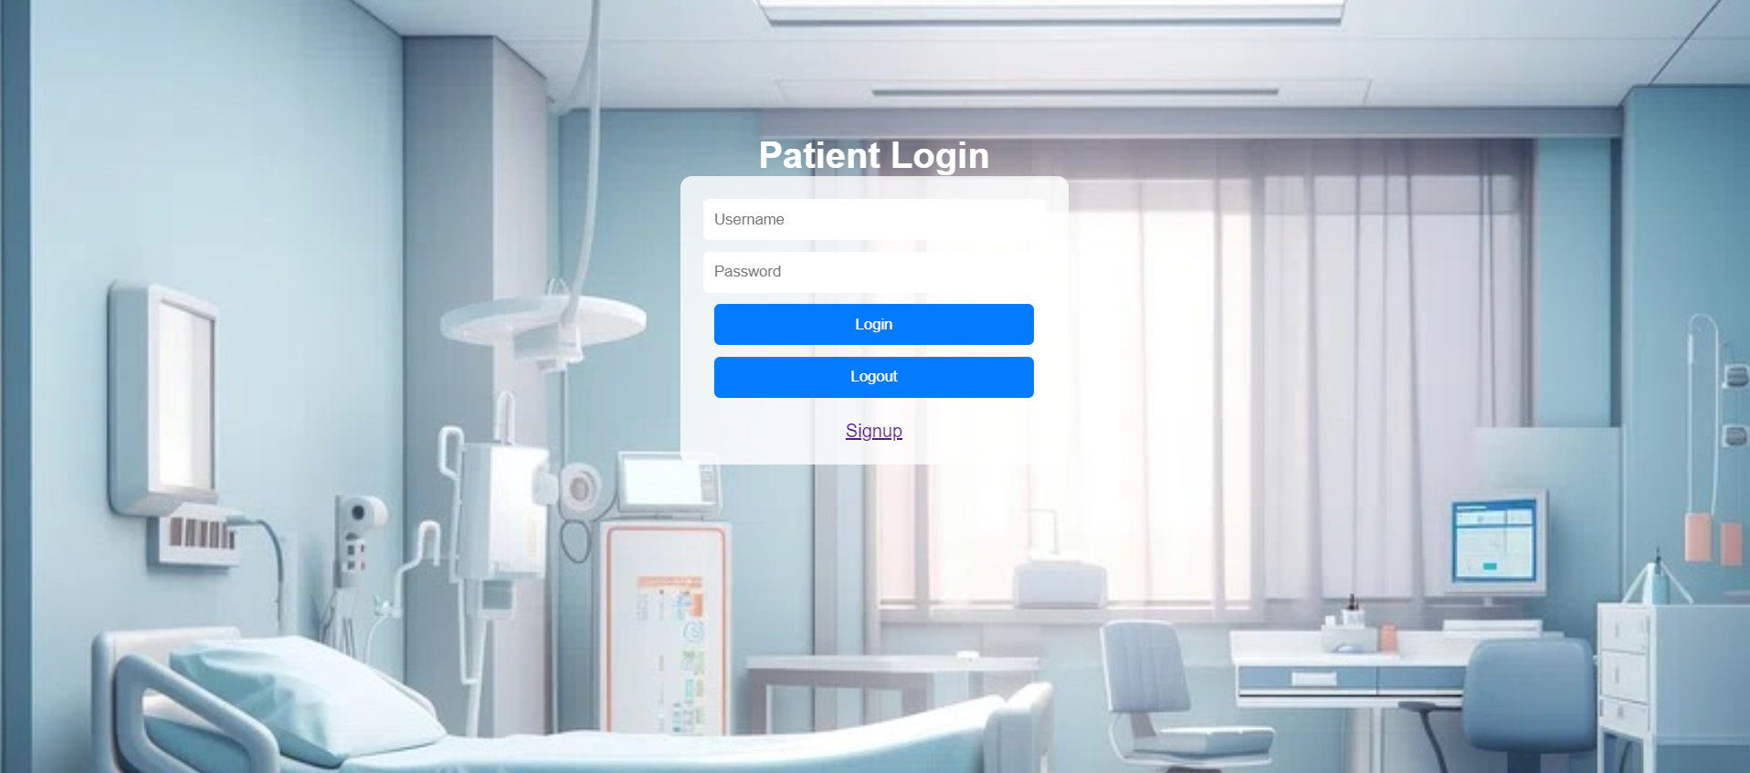
Patient Login page:

Slide 12

Hospital Login page:

Slide 13
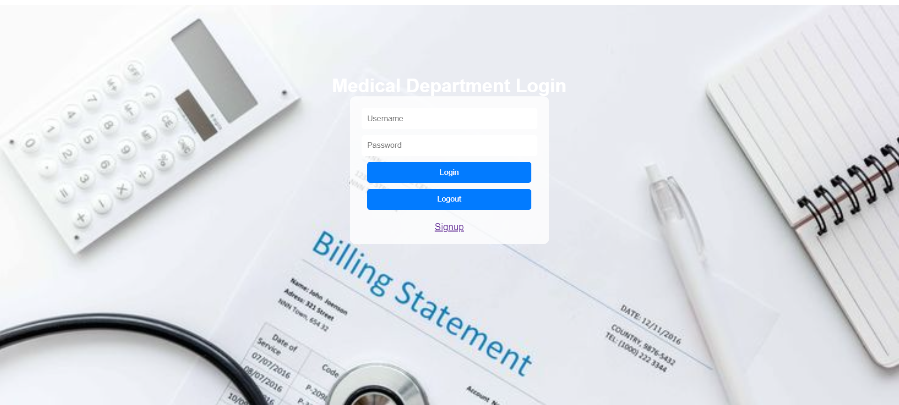
Medical Department Login page:

Slide 14
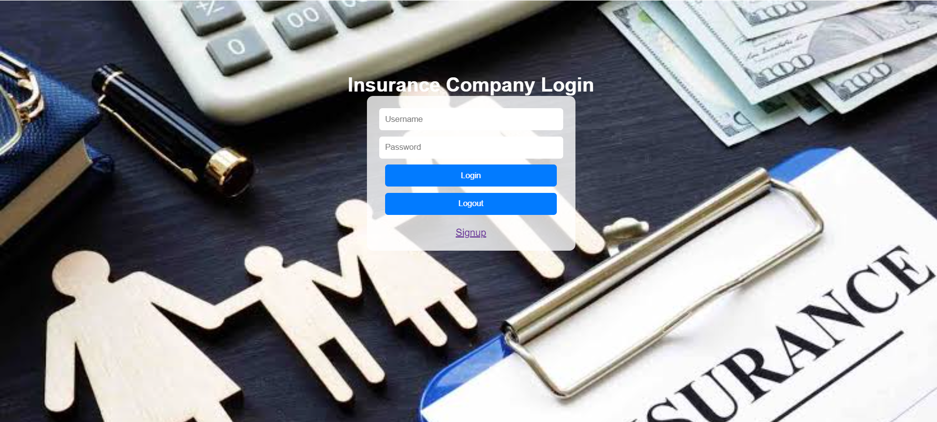
Insurance Login page:

Slide 15
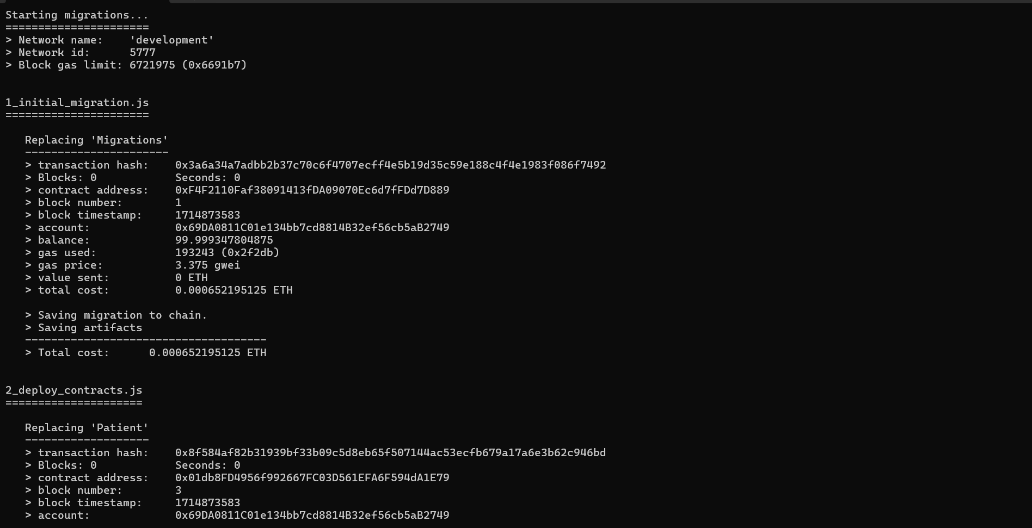
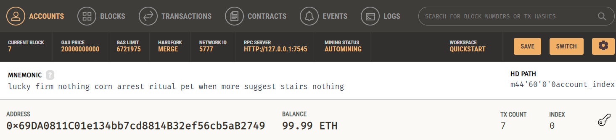
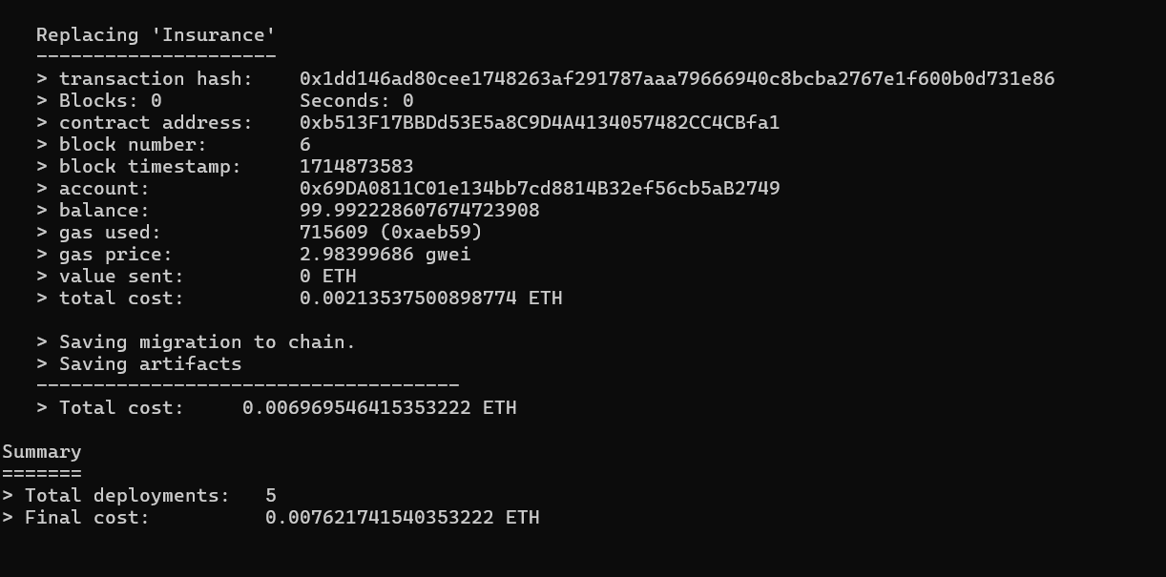
Account details after deployment:
Deployed contracts:

Slide 16
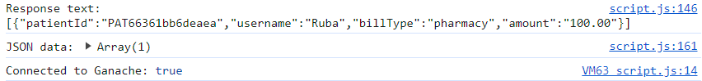
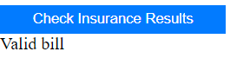
Connected to Ganache:
Final Output:

Slide 17
Conclusion
In conclusion, the development of the Patient Database Management System using blockchain technology represents a significant step forward in revolutionizing healthcare data management. Throughout the course of this project, we have successfully implemented a system that addresses key challenges faced by traditional patient database systems, including data security, transparency, and interoperability. The role-based access control system ensures that each user is provided with access to functionalities specific to their role, thereby enhancing efficiency and confidentiality in managing patient information. Patients can conveniently access and manage their medical records, while healthcare providers can securely add patient data in compliance with privacy regulations.

